Slide 1
Micro-CHP
PowerPoint presentation
Unit 301: Understand the fundamental principles and requirements of environmental technology systems

Slide 2
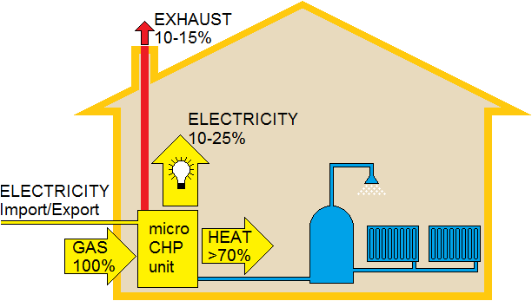
Micro-CHP
This technology generates heat and electricity simultaneously, from the same energy source, in individual homes or buildings.
The main output of a micro combined heat and power (micro‑CHP) system is heat, with some electricity generation, at a typical ratio of about 6:1 for domestic appliances.

Slide 3
Micro-CHP
A typical domestic system will generate up to 1kW of electricity once warmed up: the amount of electricity generated over a year depends on how long the system is able to run.
Any electricity you generate and don't use can be sold back to the grid.

Slide 4
Micro-CHP
Micro-CHP is a technology that provides an opportunity to use an energy source (normally gas) to effectively produce heat and electricity.
Unlike larger CHP systems (mini and full CHP) the application of micro‑CHP is typically limited to one property and does not include any need for ‘district’ heating.

Slide 5
Micro-CHP
Micro‑CHP is not classed as a renewable technology (unless fuelled by renewable biofuels) but properly applied it can reduce carbon emissions and total energy costs.
CHP is sometimes referred to as ‘cogeneration’.
The term micro-CHP normally indicates that the output of the system is less than 5kW_{e} (5kW electrical) combined with a heat output suitable to replace a domestic or small commercial boiler.

Slide 6
Stirling engine
A sealed cylinder containing a gas (such as helium) is heated at one end by the burning gas and then cooled at the other by the return heating water so that it expands and subsequently contracts and is arranged to actuate a piston to drive an electrical generator.

Slide 7
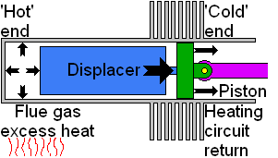
Stirling engine
Expansion
Most of the gas in the system has just been driven to the hot end of the cylinder. The gas heats and expands, driving the piston outwards to the right.

Slide 8
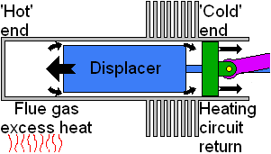
Stirling engine
Transfer
The gas has expanded. Most of the gas is still located in the hot end of the cylinder. Flywheel momentum carries the crankshaft the next quarter turn. The bulk of the gas is transferred around the displacer to the cool end of the cylinder.

Slide 9
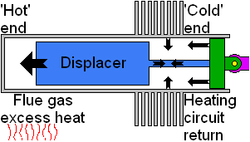
Stirling engine
Contraction
The majority of the expanded gas has shifted to the cool end. The gas cools and contracts drawing the piston inward to the left.

Slide 10
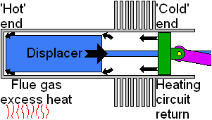
Stirling engine
Transfer
The contracted gas is still located near the cool end of the cylinder. Flywheel momentum carries the crankshaft another quarter turning, moving the displacer and transferring the bulk of the gas back to the hot end of the cylinder.

Slide 11
Planning permission and Building Regulations
Planning permission not required as long as:
Flues on the rear or side elevation of the building are allowed to a maximum of one metre above the highest part of the roof.
If the building is listed or in a designated area even if you enjoy permitted development rights it is advisable to check with your local planning authority before a flue is fitted. Consent is also likely to be needed for internal alterations.
In a conservation area or in a World Heritage Site the flue should not be fitted on the principal or side elevation if it is visible from a highway.

Slide 12
Planning permission and Building Regulations
Building Regulations must be complied with:
The installation of micro‑CHP must satisfy the requirements of Part L of the Building Regulations that covers the requirements with respect to conservation of fuel and power.
Additionally, other aspects of the work such as electrical installation and plumbing work will also have to comply, eg Part J (Heat Producing Appliances) and Part P (Electrical Safety).

Slide 13
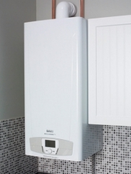
Advantages of micro-CHP
When the micro-CHP is generating heat, the unit will also generate electricity to be used in the home (or exported).
By generating electricity on-site the consumer could be saving carbon dioxide compared with using grid electricity and a standard heating boiler.
Micro-CHP is eligible for feed-in tariffs.
For the householder, there is very little difference between a micro-CHP installation and a standard boiler.
Servicing costs and maintenance are estimated to be similar to a standard boiler – although a specialist will be required.

Slide 14
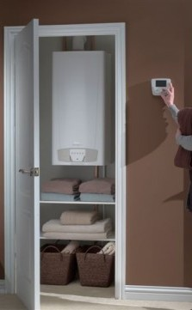
Disadvantages of micro-CHP
Micro-CHPs are still in the ‘early adaptors’ phase, meaning that prices are still relatively high and that the systems are still being adjusted.
The noise production of micro-CHPs is a relatively large problem.
Payback time is still quite high.
Not completely renewable.
Seasonal variations – may be ineffectual in responding to dynamic requirements of users particularly coping with seasonal variations; often producing excess heat during the summer period.

Slide 15
Any questions?

